Slide 1


Welcome and Introduction.
Lecture 1
Joaquim Gromicho

Slide 2
Lecture Goals
By the end of this lecture, you should be able to:
Explain how data, computing power and algorithms enable real-world impact.
Illustrate how analytics can contribute to the SDGs, while recognizing risks and unintended consequences.
Explain why Python and machine-learning foundations matter alongside GenAI.
Run, modify and check a simple Python notebook.
Describe how to use GenAI as a Socratic learning coach within the course rules.
Explain how analytics turns data into insights and better decisions.
Reading: Textbook, sections 1.1–1.5

Slide 3
The learning objectives as a journey
1 · Decision intelligence How analytics turns data into better decisions and meaningful real-world impact.
2 · What makes it possible Data, computing power and algorithms.
3 · Opportunities for good The analytics tools that help businesses improve performance can also help NGOs increase their impact and advance the Sustainable Development Goals.
4 · Your toolkit Analytics and its mathematical foundations, Python, mathematical modelling, optimization and responsible use of AI.

Slide 4

Dick den Hertog
Consultant at CQM (Eindhoven) 1992-2000
Professor at Tilburg University, 2000-2020
Professor at University of Amsterdam, 2020 - now
Visiting Professor MIT, 2019 – now
Science to Impact Director of Analytics for a Better World Institute, 2022 - now
Research: Optimization, Radiotherapy, Humanitarian Analytics, Machine Learning

Slide 5
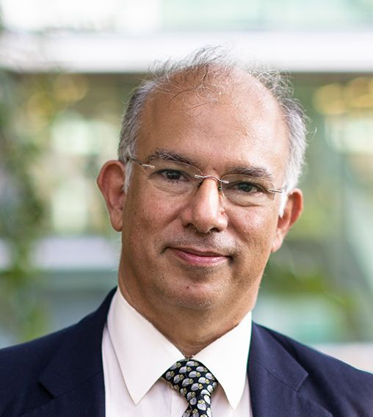









Joaquim Gromicho
Analytics for a Better World Professor at the Amsterdam Business School, University of Amsterdam.
Optimization Director at the Analytics for a Better World institute.
Since 2021
Since 2021
Formerly:
Quiz: how old am I?
2 years
4 years
29 years
20 years
6 years
15 years
8 years

Slide 6

Do Quynh Anh Ngo
Third year Business Analytics student at University of Amsterdam
Amsterdam Merit Scholarship Recipient

Slide 7
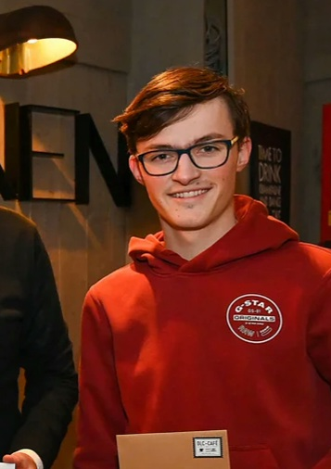
Lars Boon
Business Analytics student at University of Amsterdam
Minor Communication Science at University of Amsterdam
Second year as a TA for Analytics for a Better World

Slide 8
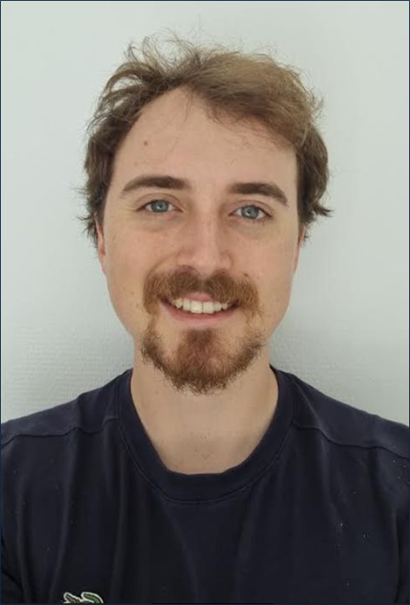
Mats van der Vlugt
Second year Mphil student Business Data Science at Tinbergen Institute focusing on Econometrics and Machine Learning methods
BSc Business Analytics at UvA
Third year as a TA for Analytics for a Better World
Research Intern at Erasmus Department of Econometrics
Research Assistant at Frankfurt School of Finance and Management

Slide 9

Nicole Guarnieri
Junior Lecturer in Business Analytics, University of Amsterdam
MSc Data Science & Business Analytics Graduate (Data Science Track), UvA
BSc Business Analytics Graduate (Honors Programme, Cum Laude), UvA
Minor Macroeconomics: International and Monetary Economics, UvA
Previous teaching-assistant experience:
Mathematics 1 for Economics
Statistics 1,2 for Economics
Analytics for a Better World (three years)

Slide 10
Lectures and coordination
Website: Course page on Canvas
Textbook: Introduction to Operations Research, 11th edition Hillier and Lieberman, McGraw Hill Please read the textbook announcement on Canvas.
Instructors
Dick den Hertog — Course coordinator d.denhertog@uva.nl
Joaquim Gromicho j.a.s.gromicho@uva.nl

Slide 11
Tutorials and additional teaching materials
Teaching assistant | Groups and times | Email
Quynh Anh Ngo | Group 1: 09:00–10:45; Group 4: 11:00–12:45 | d.q.a.ngo@uva.nl
Lars Boon | Group 2: 11:00–12:45; Group 3: 15:00–16:45 | l.s.boon@uva.nl
Mats van der Vlugt | Group 5: 15:00–16:45; tutorial and technical coordination | m.vandervlugt2@uva.nl
Nicole Guarnieri | Grading and coordination of teaching materials | n.guarnieri@uva.nl

Slide 12
Public transport strike: tutorial arrangements on Wednesday September 9
The nationwide strike may disrupt travel to campus.
On-campus tutorials will exceptionally be hybrid, allowing online participation.
Some tutorials may take place entirely online.
Check Canvas for your group’s arrangements and meeting link.
These are exceptional arrangements. Tutorials normally take place in person, and attendance is recorded.

Slide 13

Final Grade, see also this announcement
6 individual, weekly, computer assignments and a final assignment.
4 out of the 6 weekly assignments, and the final assignment should get a PASS
Your final grade is composed of:
100%: written examination
- individual, closed book handwritten exam. https://sefa.nl/study/other-products/
Canvas includes example exams.

Slide 14

Analytics
“The scientific process of transforming data into insight for making better decisions”

Slide 15
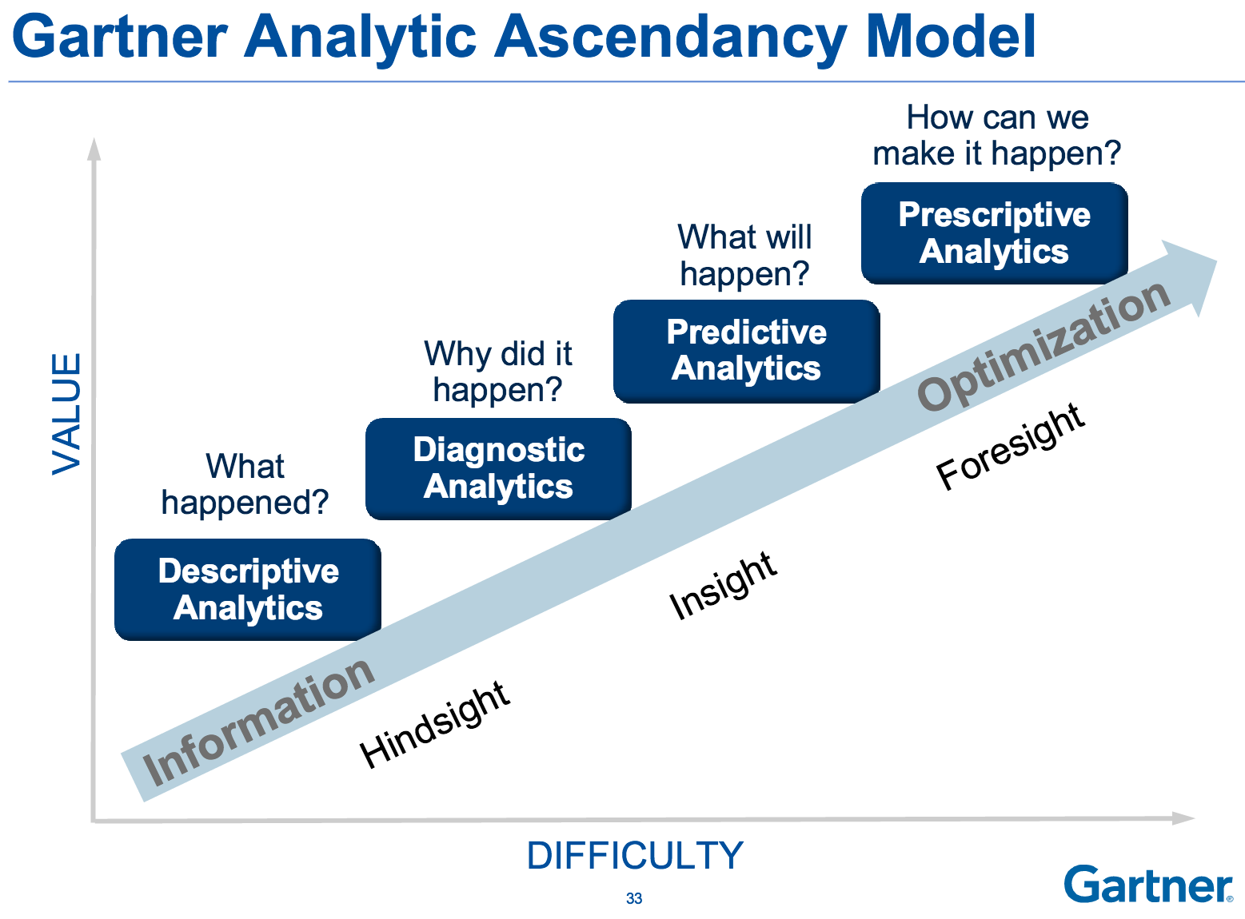
Four parts of analytics

Slide 16
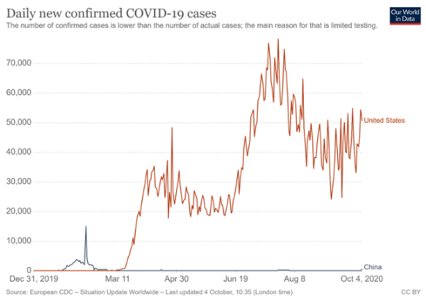
Covid-19 example
Descriptive Analytics

Slide 17
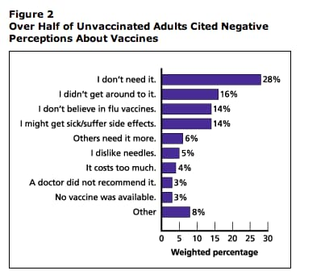
Covid-19 example
Diagnostic
Analytics

Slide 18
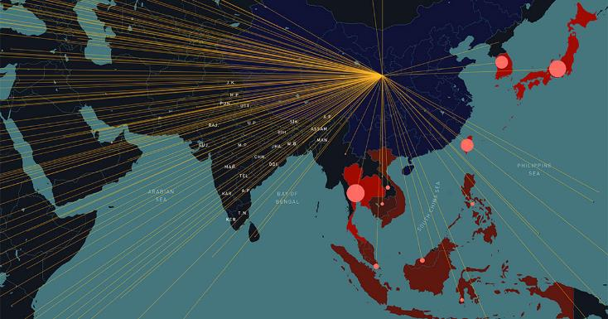
Covid-19 example
Predictive Analytics

Slide 19
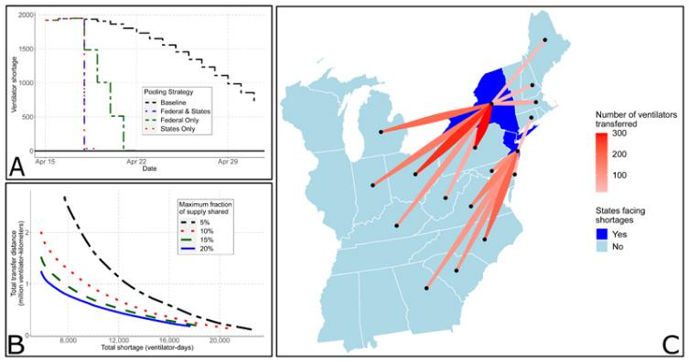
Covid-19 example
Prescriptive Analytics
Source: Bertsimas et al. (2020)

Slide 20
Predictive Analytics
Data Mining
Machine Learning
Stochastics
Text Mining
Process Mining
Deep Learning
Predictive
Analytics
Support Vector Machines
Video Mining
…….
Symbolic Regression
Visualization
20

Slide 21
Prescriptive Analytics
Linear Optimization
Simulation
Conic and Nonlinear Optimization
Decision trees
Mixed Integer Optimization
Combinatorial
Optimization
Stochastic Programming
Prescriptive
Analytics
Shortest Path Algorithm
Robust Optimization
Simulated Annealing
Multi-objective optimization
Local Search Techniques

Slide 22
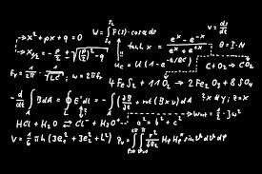
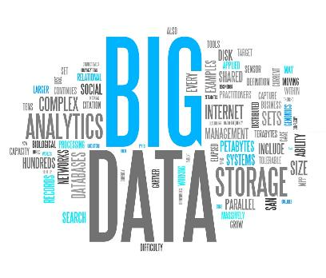
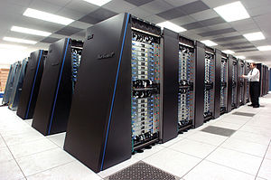
Big Data Big Calculations

Slide 23
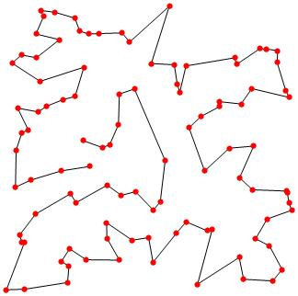
Small Data – Big Calculations
We would like to visit 25 adresses …
What is the shortest route ?
Enumerating all possibilities:
how many minutes computer time ?

Slide 24
Small Data – Big Calculations
We would like to visit 25 adresses …
What is the shortest route ?
Enumerating all possibilities:
millions of years
Efficient algorithm:
a few seconds

Slide 25
Enablers of Analytics
Datafication of the world
Data storage has become extremely cheap
Computer power has increased a lot
Much better algorithms

Slide 26
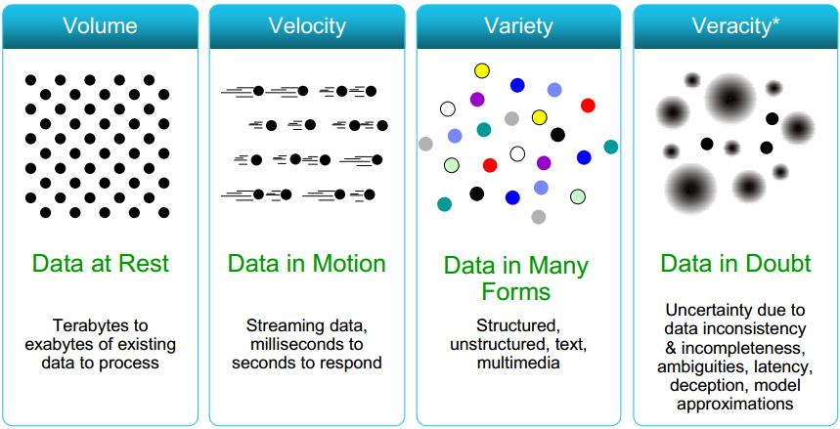
Data, data, data, …

Slide 27
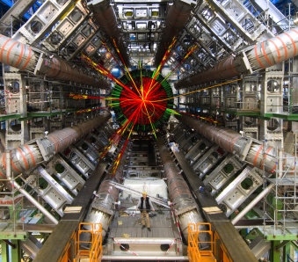
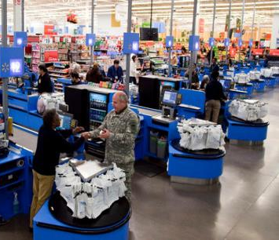
The World produces its events …
Large Hadron Collider
Walmart
40 million events per second
40 million transactions per day

Slide 28
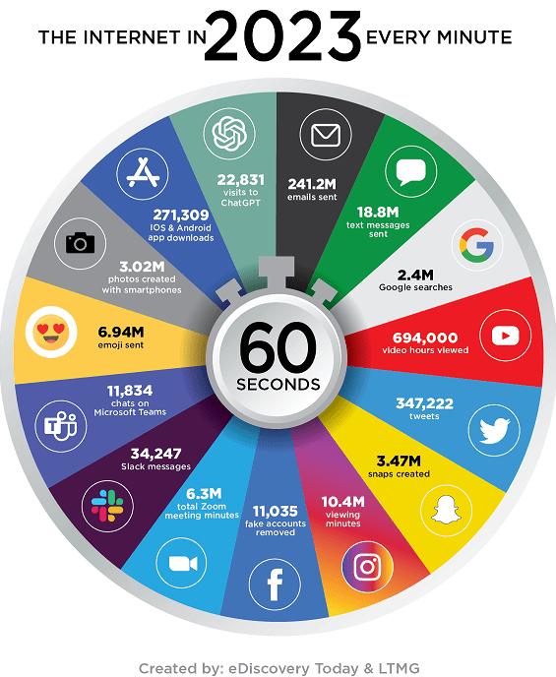
Datafication of the world

Slide 29
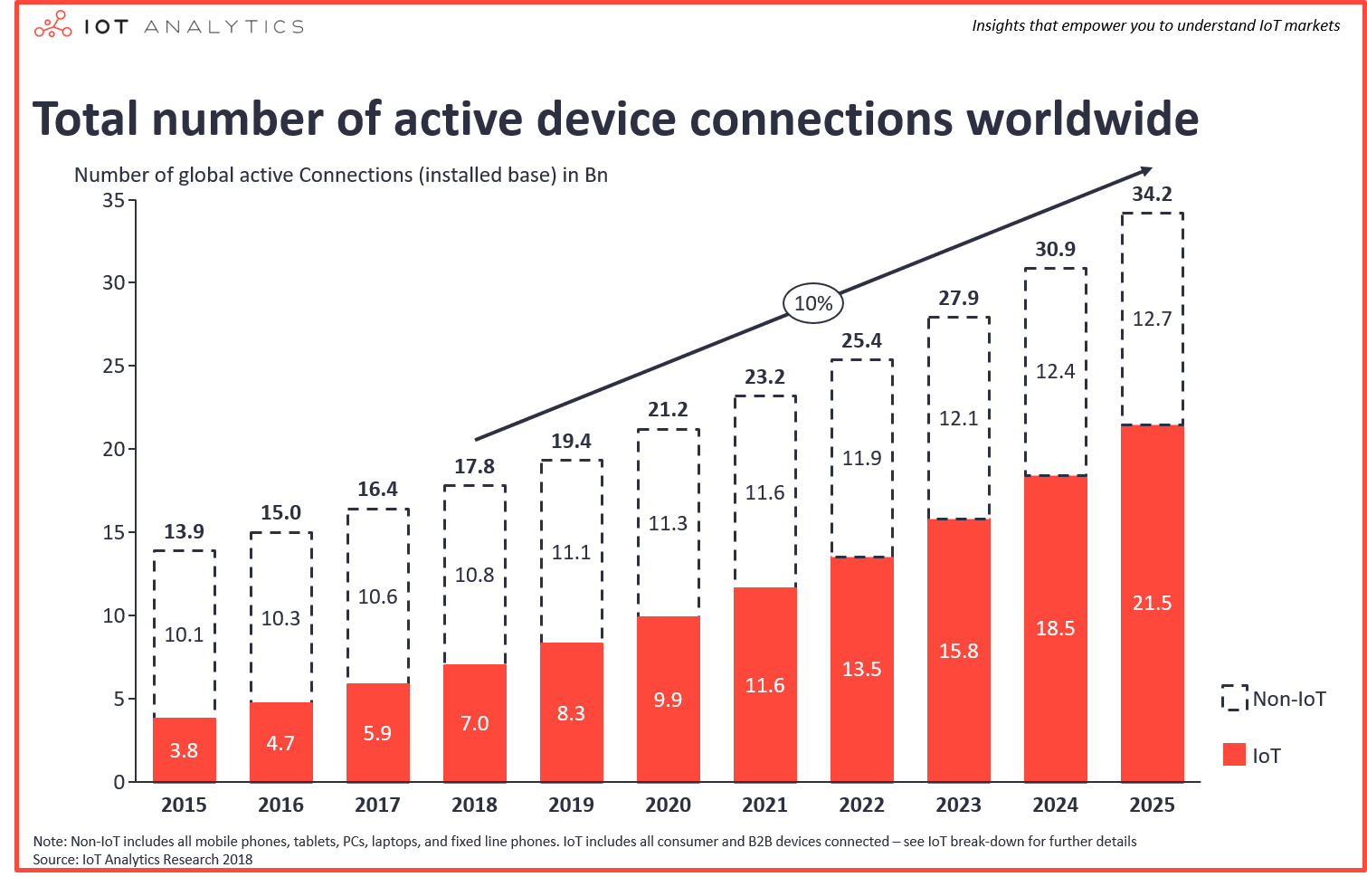
Internet of Things
Including predictions: https://iot-analytics.com/number-connected-iot-devices/

Slide 30
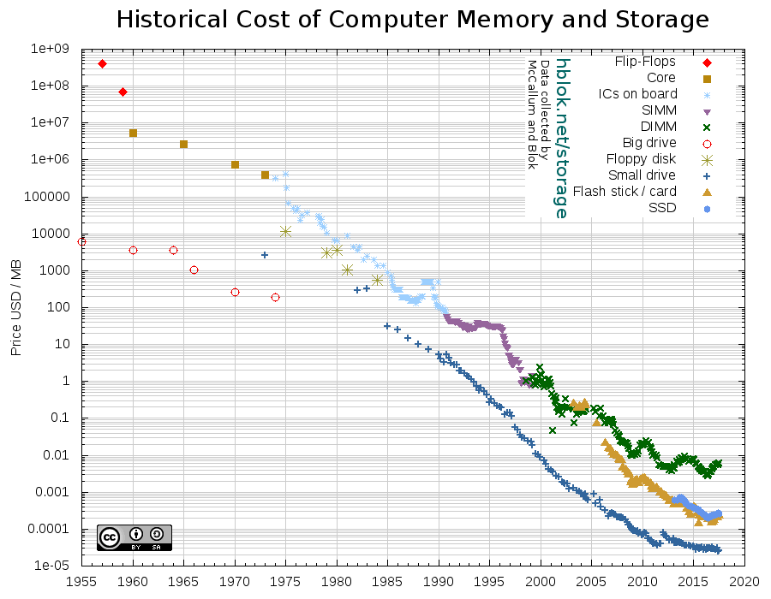
Data storage
See also https://ourworldindata.org/grapher/historical-cost-of-computer-memory-and-storage

Slide 31
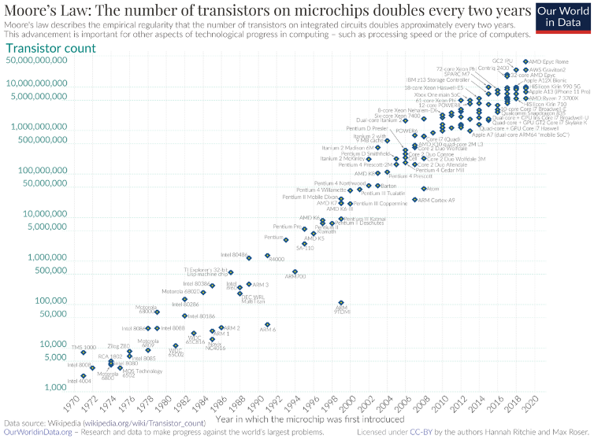
Moore’s Law
See also https://ourworldindata.org/grapher/transistors-per-microprocessor

Slide 32
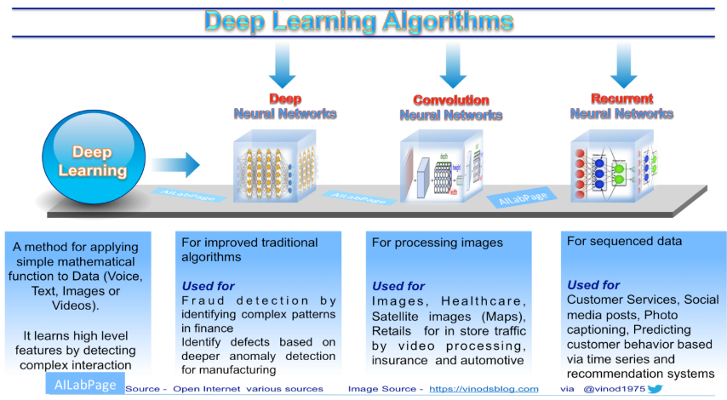
Better algorithms for predictive analytics

Slide 33
Better algorithms for prescriptive analytics
Mixed Integer Linear Optimization Speedup, Gurobi, 1991 – 2017:
Over 1.3 million times faster
or
Factor 1.8 faster per year
Source: R.E. Bixby (2017) at https://ecco2017.euro-online.org/en/resources/files/invited-speakers/robertbixby.pdf , For more recent speedups see https://cdn.gurobi.com/wp-content/uploads/2025-11-25_Whats-New-in-V13.pdf

Slide 34
Traveling Salesman Problem (1)
We would like to visit 25 adresses …
What is the shortest route ?
Enumerating all possibilities:
millions of years
Efficient algorithm:
a few seconds

Slide 35
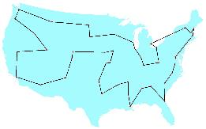
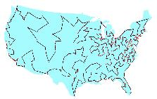
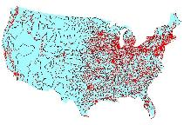
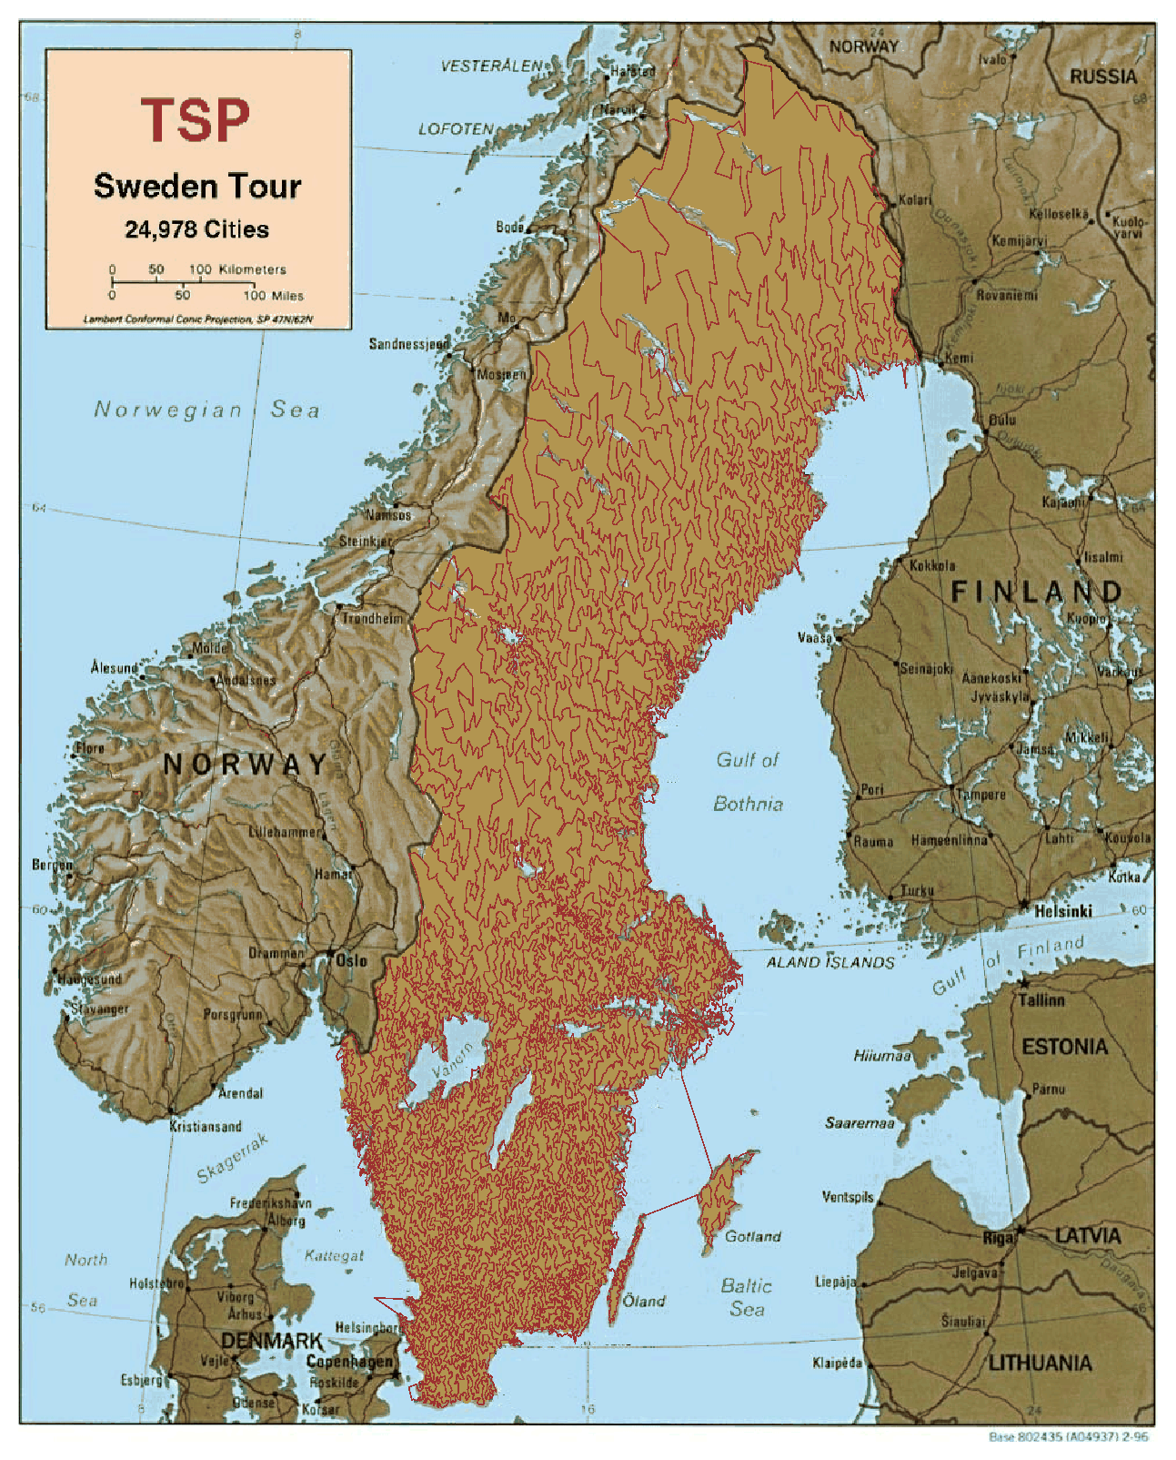
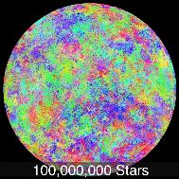
Traveling Salesman Problem (2)
1954
1987
1998
42 cities
532 cities
13,509 cities
2004
2020
……
24,978 cities
More on https://www.math.uwaterloo.ca/tsp/

Slide 36
The dark and light side…

Slide 37

Dark side of Analytics…

Slide 38
Dark side of Analytics
False assumptions in the theory and/or the statistical model
A model is always backward looking; it is a view of yesterday’s world
Build with the data you have, not the data you need
No feedback: Statistical systems require feedback to tell them they are off-track

Slide 39
Dark side of Analytics
Real-life effects of model mistakes
Models may go against morality (e.g. fairness, harmfullness)
People will game the system
Digital Taylorization; treating man as a machine
Privileged processed by people, masses by machines
Personalization gone too far: everybody in its own bulb

Slide 40

ABW - examples

Slide 41



Optimization of dike heights

Slide 42


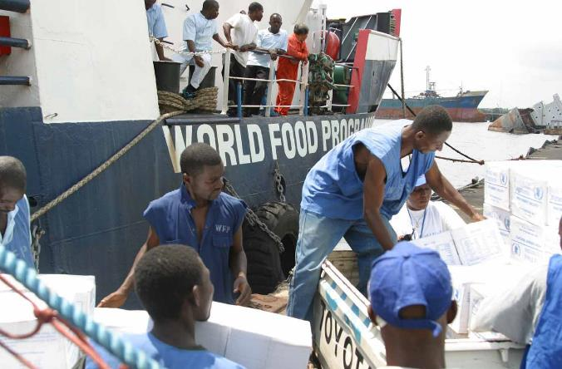
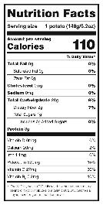

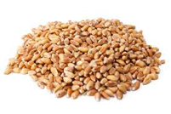
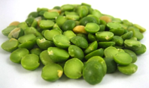

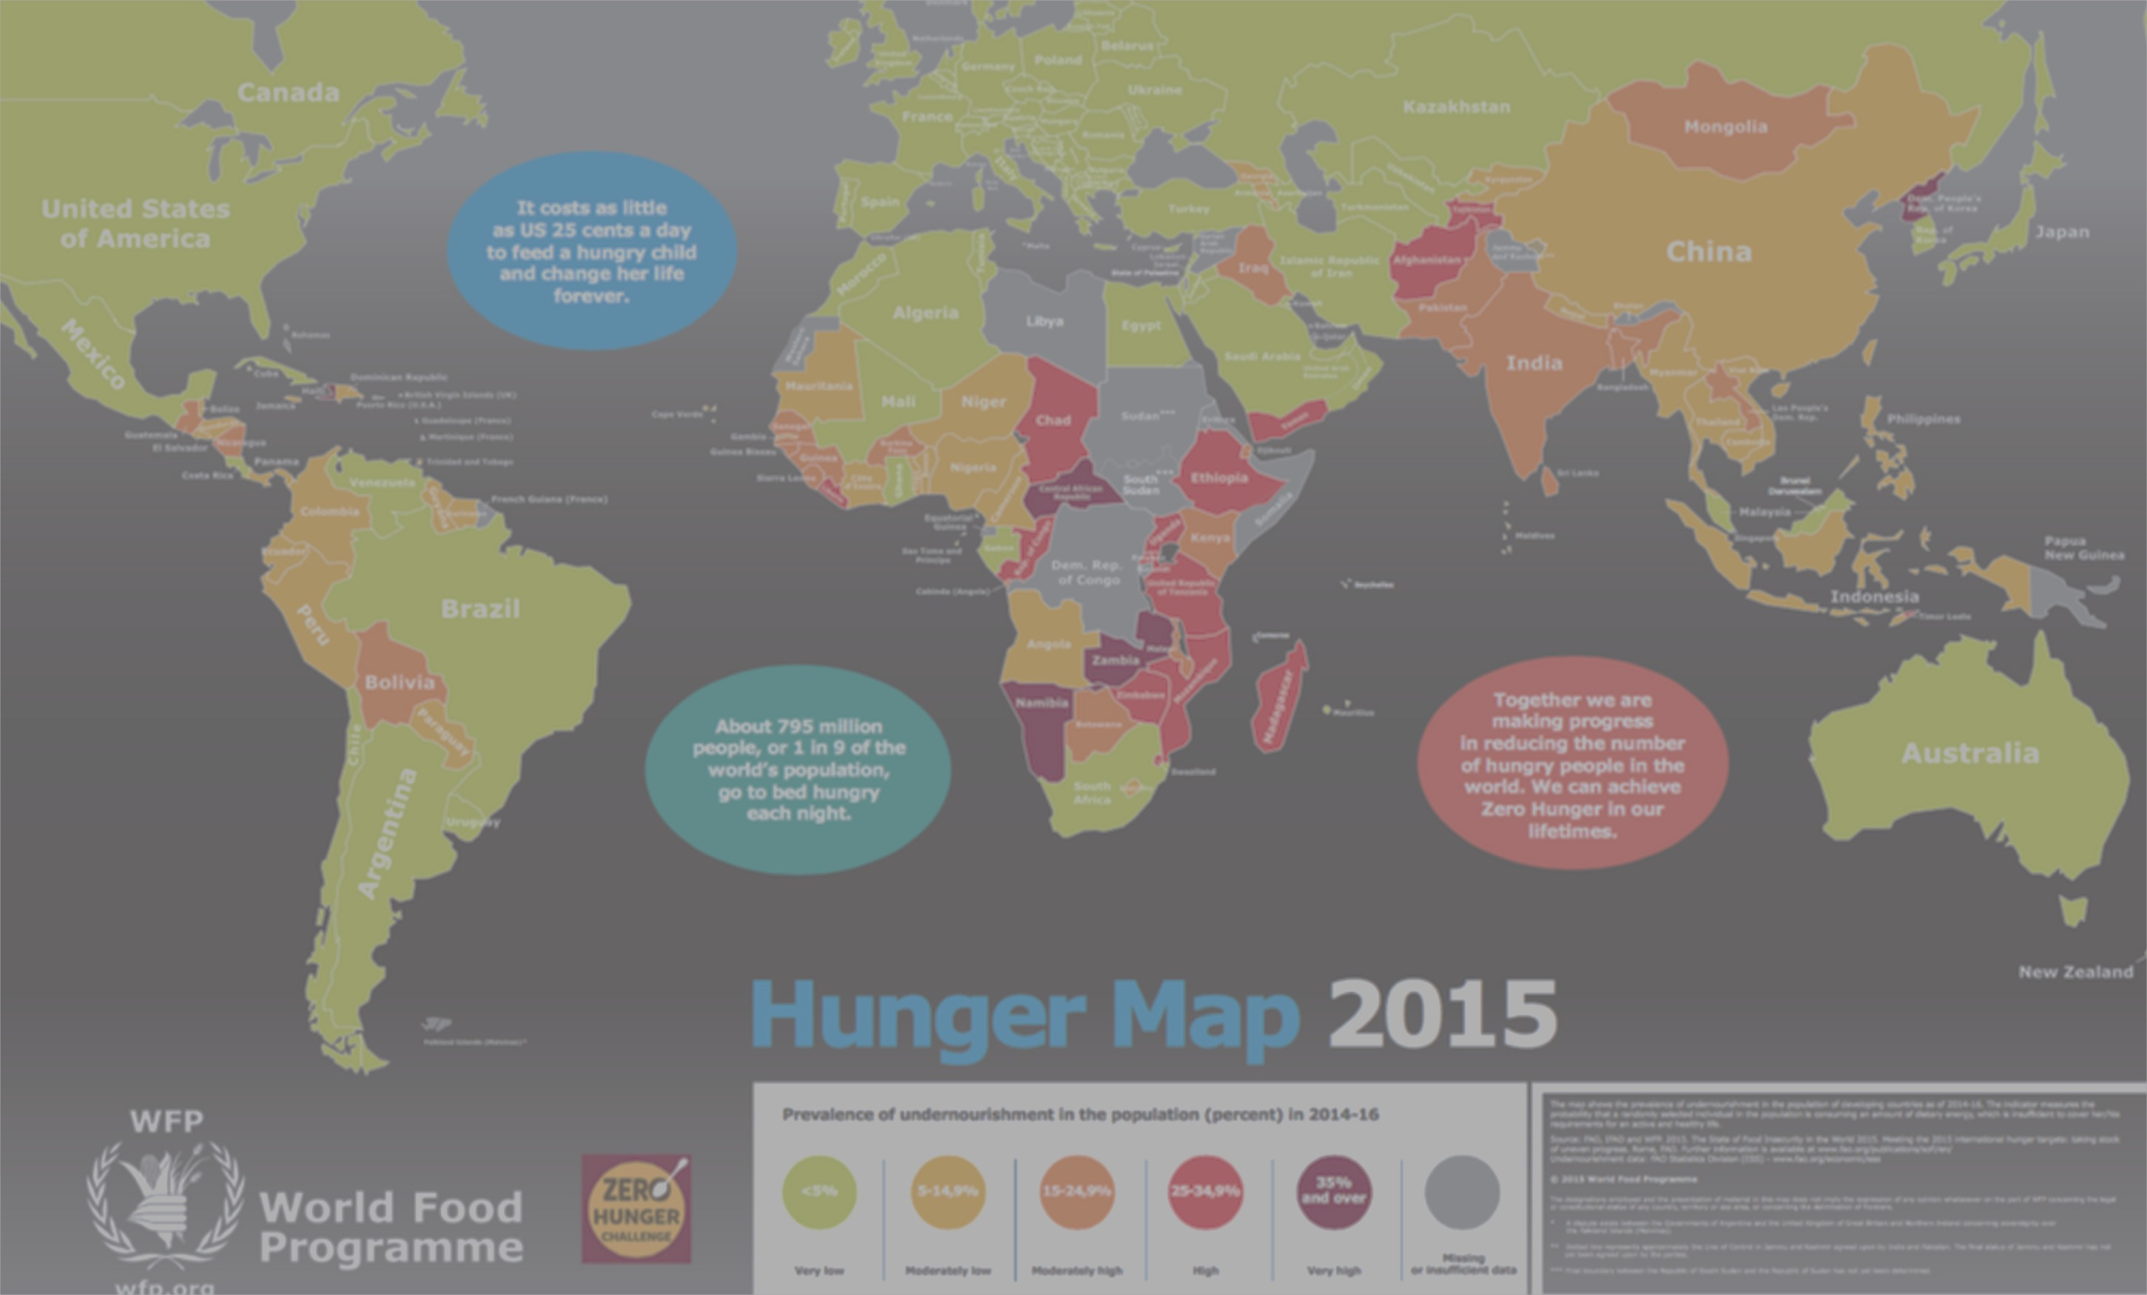
Analytics for Zero Hunger

Slide 43



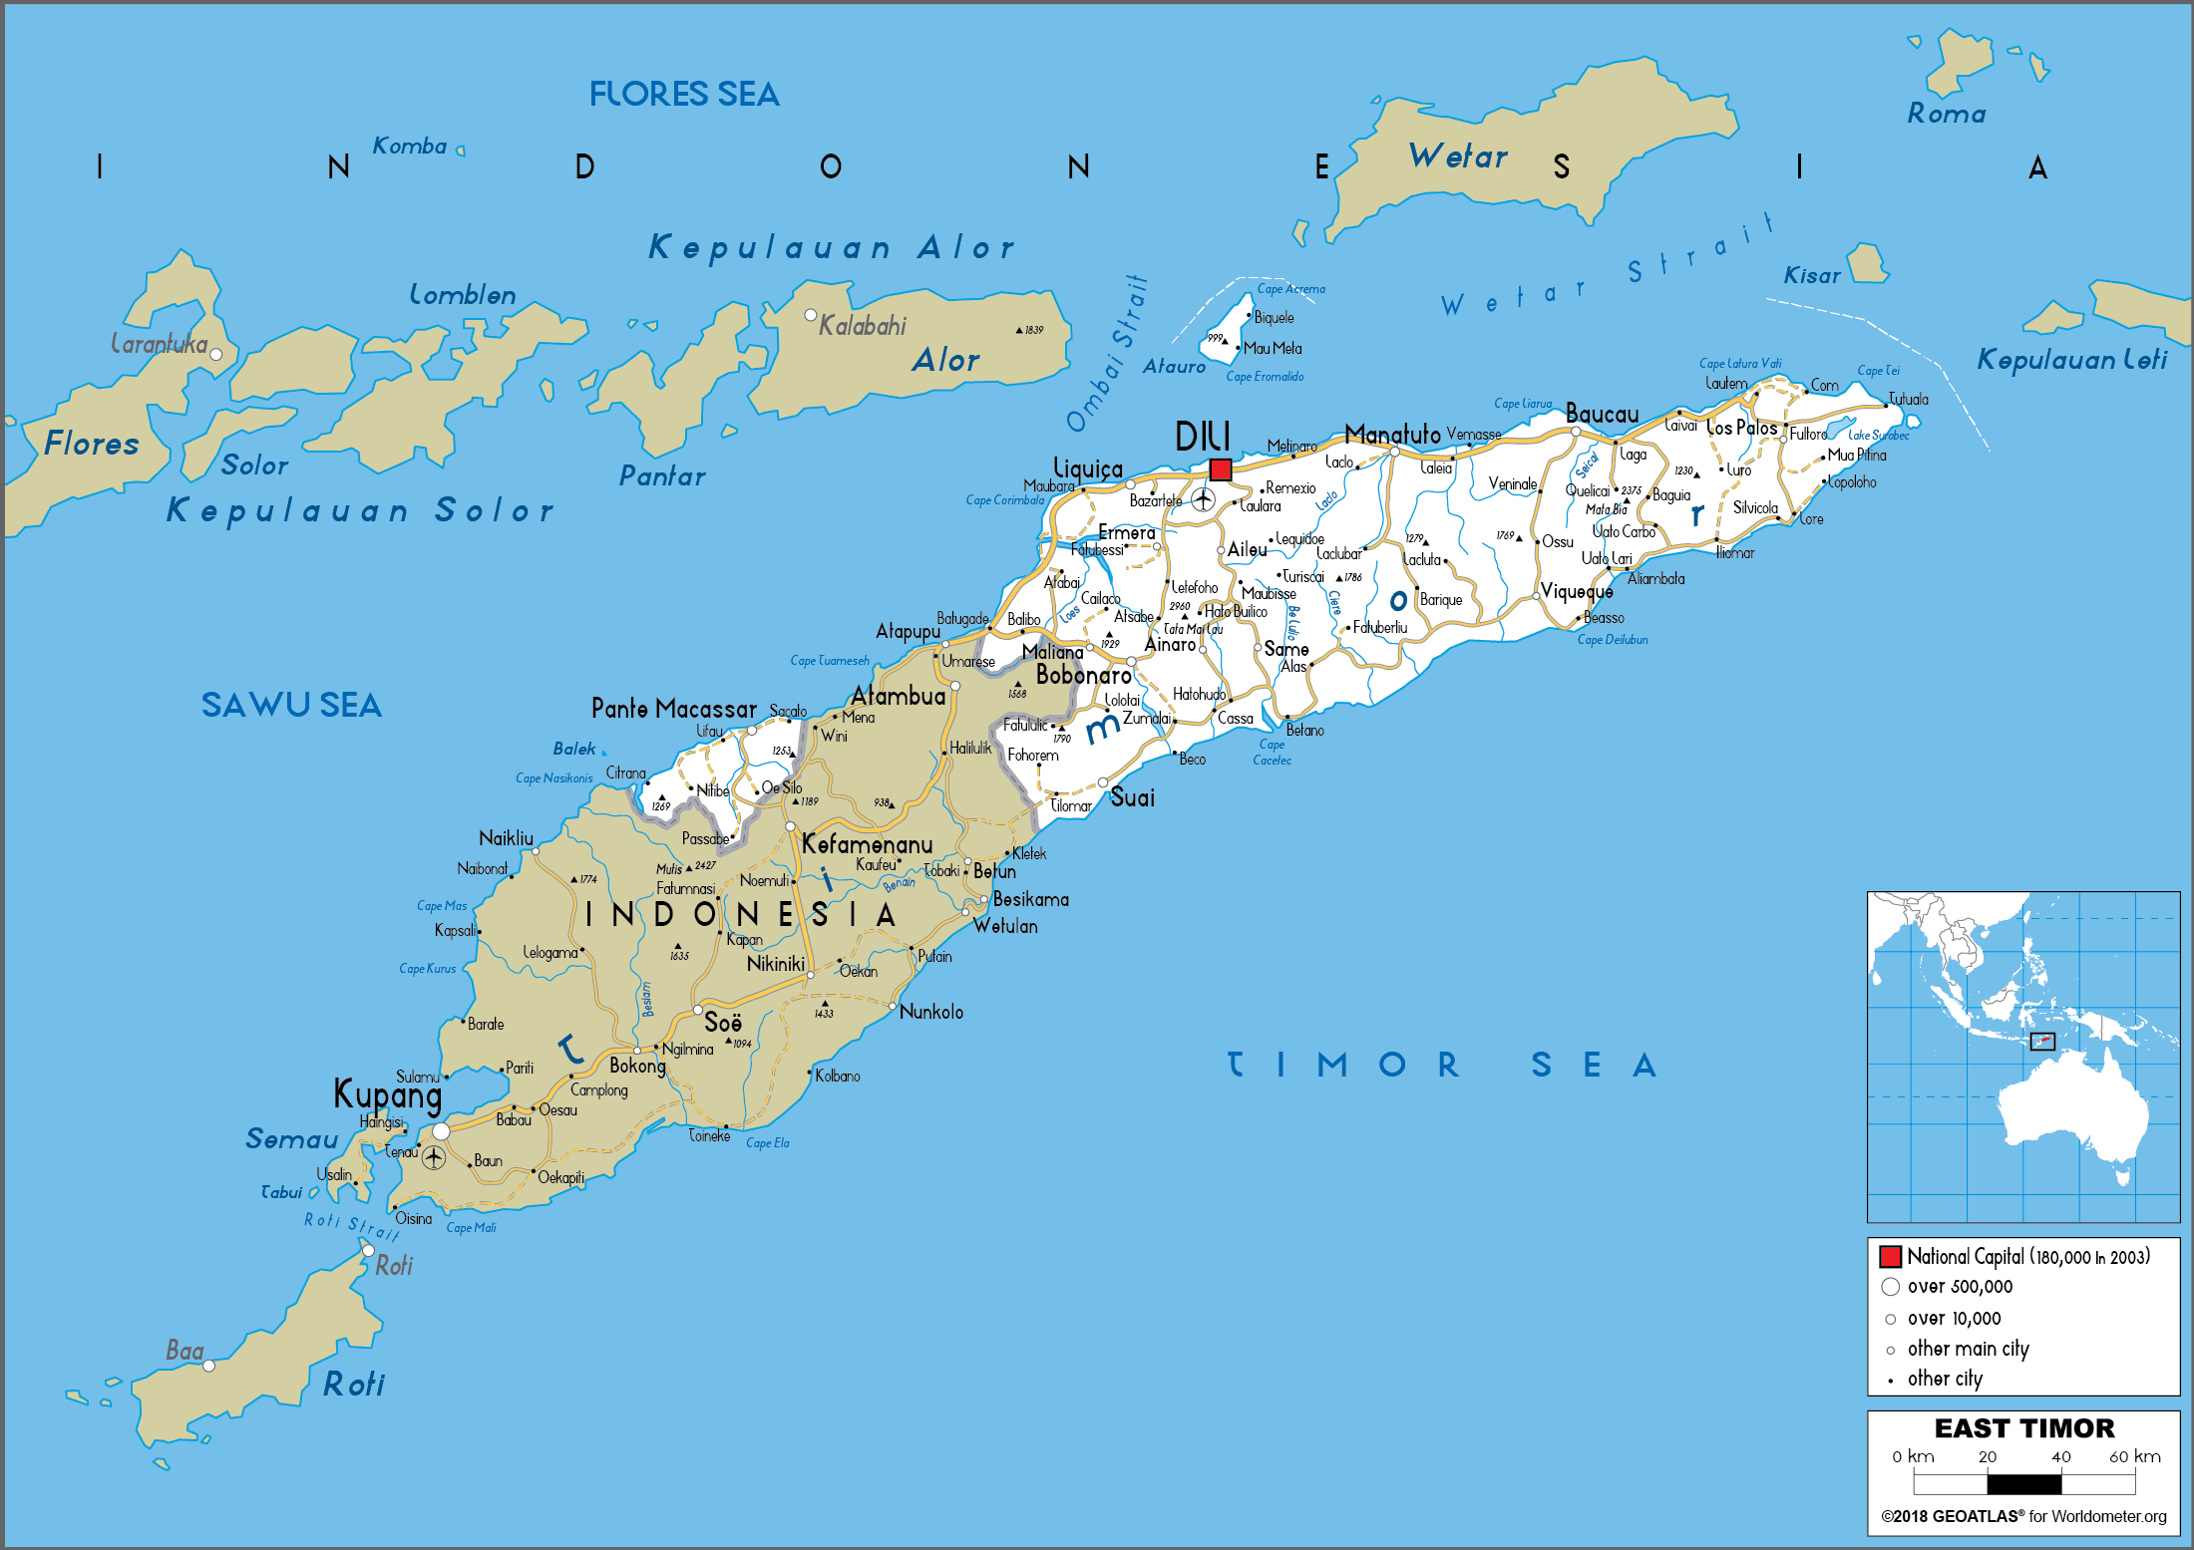
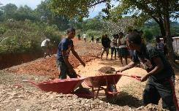


Investment infrastructure Timor Leste

Slide 44


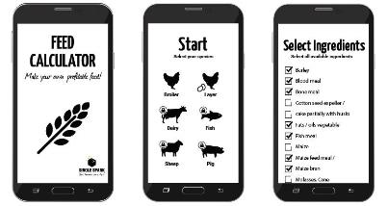
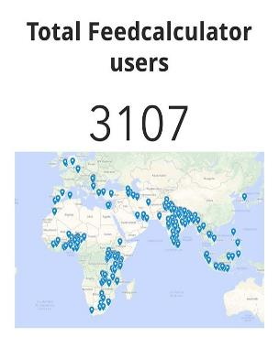
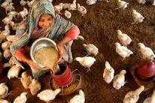
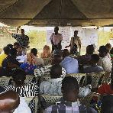
Optimizing feed for cattle for small farmers
15,000

Slide 45
The curriculum year 1
Analytics
Business
Computer science
1st Semester |  |  | 2nd Semester
Block 1 | Block 2 | Block 3 | Block 4 | Block 5 | Block 6
Mathematics 1: Calculus (6011P0166) | Probability Theory and Statistics 1 (6011P0168) | Data Visualisation and Storytelling (6011P0806) | Mathematics 2: Linear Algebra (6011P0171) | Probability Theory and Statistics 2 (6011P0173) | Introduction Data Science (6011P0300)
Analytics for a Better World (6011P0803) | Programming with Computational Thinking (6011P0805) |  | Finance for Quantitative Economics (6011P0504) | AI, Privacy & Global Cybersecurity for BA 6011P0804
Notes:
Learn to solve business- and organisation-related problems by focusing on computational approaches and techniques, predictive analytics and data science skills.

Slide 46
The curriculum year 2
Analytics
Business
Computer science
1st Semester |  |  | 2nd Semester
Block 1 | Block 2 | Block 3 | Block 4 | Block 5 | Block 6
Mathematics 3: Advanced Linear Algebra (6012B0650) | Operations Research – Deterministic Methods (6012B0801) | International Management Consulting – Operation Excellence (6012B0510) | Econometrics 1 (6012B0374) | Operations Research – Stochastic Methods (6012B0805) | Entrepre- neurship Hackathon 6012B0807
Algorithms & Data Structures in Python · 6012B0810 Plan Your Programme · 6010E1001 | Machine Learning (6012B0809) |  | HR Analytics (6012B0804) | Accounting and Control (6012B0806)
Notes:
Learn to solve business- and organisation-related problems by focusing on computational approaches and techniques, predictive analytics and data science skills.

Slide 47
The curriculum year 3
Analytics
Business
Computer science
1st Semester |  |  | 2nd Semester
Block 1 | Block 2 | Block 3 | Block 4 | Block 5 | Block 6
Bachelor’s Internship Business Analytics (6013B0807) / International exchange / Minor / Electives |  |  | Language Technologies and Models (6013B0808) | Computer Systems and Engineering – Information and Data Management (6013B0803) | Thesis Seminar Research Project 6013B0810 · B5–B6
 |  |  | Marketing Analytics (6013B0806) | Skills · B5–B6 6013B0809
Notes:
Learn to solve business- and organisation-related problems by focusing on computational approaches and techniques, predictive analytics and data science skills.

Slide 48
Lecture Goals
Understand why we use Python in this course
Learn to work with notebooks in the cloud
Learn how to use notebooks locally
Make the best use of the weekly tutorials

Slide 49


This course is very hands-on… how and on what?
The book by Hillier and Lieberman uses Microsoft Excel for simple computations and Lindo for optimization models. However, Lindo is no longer widely used.
Instead, we will use Python for all computations.
Python is the preferred language throughout the Business Analytics program and is the de facto standard for most professionals in data science and analytics.

Slide 50
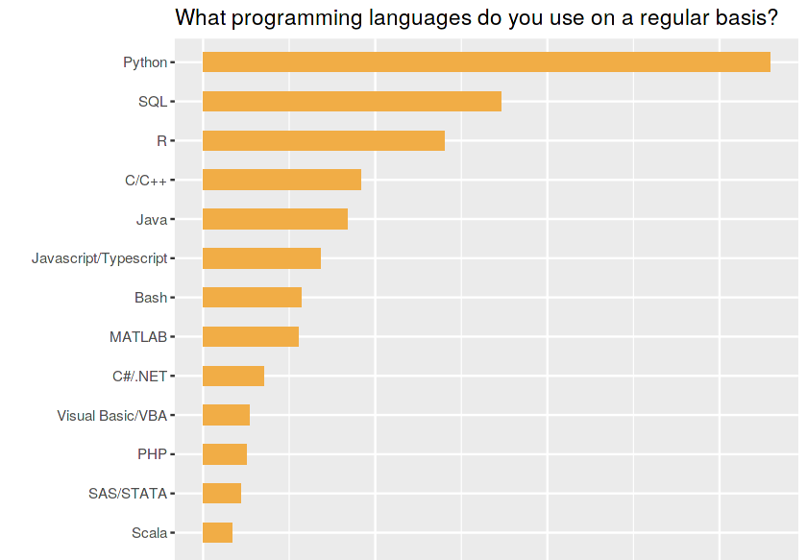
Why python? Let's ask the world…
According to simplilearn.com, Python is the best language to learn, regardless of your profession and interests.
The TIOBE Index consistently ranks Python as the number one programming language.
TechRadar reports that about three quarters of all developers use Python and intend to continue doing so.
The Kaggle community, strong in analytics, predominantly uses Python, as shown on the right.

Slide 51
Python is also a tool used by AI assistants
AI assistants can write and execute Python to analyse data and create visualisations.
Knowing Python helps you inspect, test, adapt and reproduce their work.
Understanding analytics helps you judge whether the code uses the right data and methods.
Code that runs is not necessarily an analysis you can trust.

Slide 52

Our preferred environment
The concept of a notebook is powerful: it combines formatted text, code, and results in one place. Here is an example of a notebook!
Jupyter notebooks natively support Python but can run over 40 languages.
Many distributions exist, but we will not recommend any specific one.
If you install Python and Jupyter locally, you are responsible for maintaining and troubleshooting your setup.
We will not provide technical support for personal installations.
For more information, see jupyter.org.

Slide 53

Jupyter from a cloud in your browser: a gift from Google
Google offers the Colaboratory (Colab).
This is a blessing that we gladly use in our course: each notebook runs on a virtual machine deployed by Google for it, for free.
Means that it runs without installation on your machine regardless of the machine type!

Slide 54
Jupyter from a cloud in your browser: a gift from Google
Google offers the Colaboratory (Colab).
This is a blessing that we gladly use in our course: each notebook runs on a virtual machine deployed by Google for it, for free.
Means that it runs without installation on your machine regardless of the machine type!

Slide 55

Jupyter from a cloud in your browser: a gift from Google
Google offers the Colaboratory (Colab).
This is a blessing that we gladly use in our course: each notebook runs on a virtual machine deployed by Google for it, for free.
Means that it runs without installation on your machine regardless of the machine type!

Slide 56
Without colab
If you prefer not to use a Google account, you can run all notebooks locally.
In that case, you must install Python and Jupyter yourself and maintain your environment.
To demonstrate how to work locally, let us open again this notebook…

Slide 57
Learning Python
If you already know another programming language, you will find Python easy to learn through our examples and exercises.
We suggest using Programiz for self-study and codingbat to test your knowledge.
Please use this notebook as a reference to the concepts that you should understand. You can start by skipping the rest for now.

Slide 58
Guidance for self-study
We provide a wide range of interactive notebooks throughout the course, designed to help you learn by doing.
Self-study notebook 1 (week 1)
Self-study notebook 2 (week 2)
Start at your convenience.

Slide 59
Weekly assignments
As you can see in this announcement, you need to pass assignments to access the exam.
The first six are individual and you must pass at least four
The seventh is a group assignment (in teams of three) and you must pass it.
The individual assignments are automatically graded using CodeGrade.
We will now explain how CodeGrade works and guide you step by step through submitting your first assignment. For this reason, the first week’s assignment yields no points—it is meant to help you become familiar with the system.

Slide 60
Locating the CodeGrade assignments
Access Canvas and open the course Analytics for a Better World.
1
Click on the Assignments tab.
2
Locate the weekly assignment (it may not appear until released).
3
Open the assignment and follow the link to a Colab notebook with that week’s questions.
4

Slide 61
Completing CodeGrade assignments
The notebook contains sections marked with:
### BEGIN SOLUTION …
### END SOLUTION
1
Write your answers there!!!
2
You can edit the notebook directly in Colab (recommended).
Alternatively, use local Python software, but make sure it can run .ipynb files.
3
Save your work and download the notebook as a .ipynb file.
4

Slide 62
Submitting CodeGrade assignments
In Canvas, return to the assignment page.
1
Click Load [assignment_name] in a new window, which opens CodeGrade.
2
Create a submission and upload your .ipynb file.
3
Check your status and score in CodeGrade.
4

Slide 63
More than grading, also feedback!
You may resubmit as many times as you like before the deadline—use this as free feedback!

Slide 64
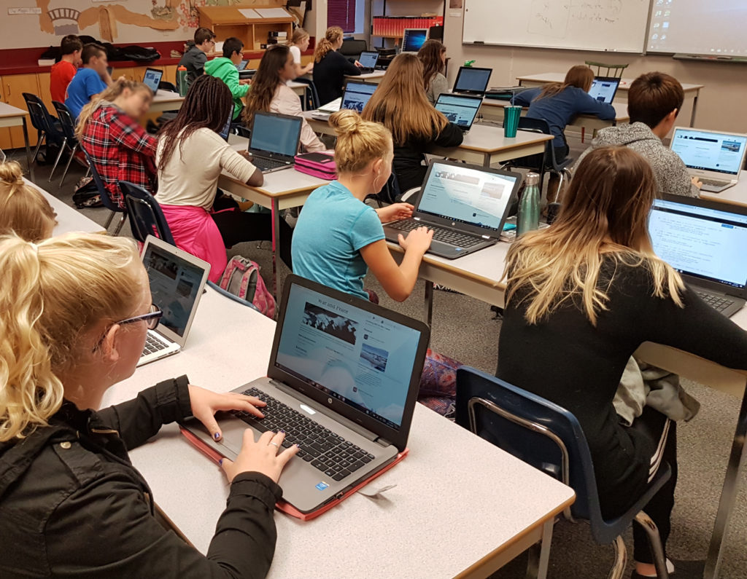
The tutorials / seminars
Each seminar focuses on the exercises of the week.
This week includes: a step-by-step introduction to submitting assignments (Colab + CodeGrade).
During seminars, you will get help with the exercises you found difficult.
You are expected to try the exercises in advance!
If you have a laptop, please bring it so we can assist you directly.
At the end of the week, we will post the solutions and the next week’s exercises on Canvas.

Slide 65
May I drive our car?
My oldest daughter is about to start driving lessons.
She asked whether she could drive our family car once she has her licence.
My answer: “Yes—but for the first year, without relying on automated driving.”
I want her to develop the judgment she will need when the assistance is unavailable.

Slide 66
AF447: when the autopilot disconnected
1 June 2009 · Rio de Janeiro → Paris
Airspeed readings became unreliable.
The autopilot disconnected.
A stall developed.
The crew did not recognize the stall and recover the aircraft.
All 228 people on board died.

Slide 67
Taking over requires preparation
The investigation identified several contributing factors:
Insufficient preparation for manual flying at high altitude.
Difficulty interpreting cockpit information and recognizing the stall.
Surprise, workload, and breakdowns in crew coordination.
Being responsible for a system is not enough. You must be prepared to understand and intervene.

Slide 68
Training and simulators were strengthened
2012 — Recommendations More realistic simulator exercises, better preparation for surprise, and stronger practical training. BEA recommendations, pages 2–4
2018 — Simulator standards EASA strengthened simulator specifications to support more realistic stall and upset training. EASA follow-up, pages 38–39
2019 — Mandatory training expanded Upset prevention and recovery training became mandatory in specified professional pilot and aircraft-rating courses. EU Regulation 2018/1974
Competence must be maintained through practice.

Slide 69
Why we still learn Python
AI can write code. You still need to:
Understand what the code should do.
Test whether the result makes sense.
Investigate and correct mistakes.
To remain in control, you need the competence to take control.

Slide 70
What have we learned?
Why we use Python
The concept of a Jupyter notebook
How to use Colab (cloud) and Jupyter locally
How CodeGrade works
Why attending tutorials is important! We expect you attend all tutorials.

Slide 71
What have we learned?
What is Analytics
Important role of ‘data’
The dark and bright side of Analytics

